Slide 1
Bagging in Python
Data Sets: bankloan.csv and petrol_consumption.csv

Slide 2
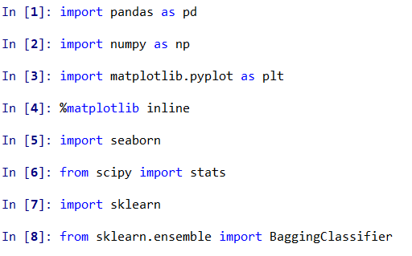
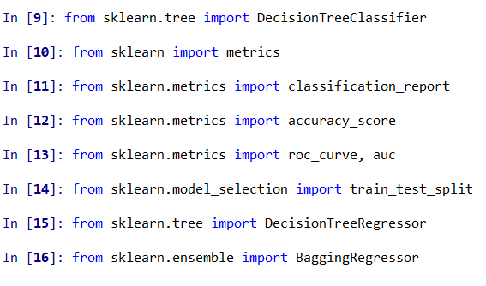
Import libraries/packages

Slide 3
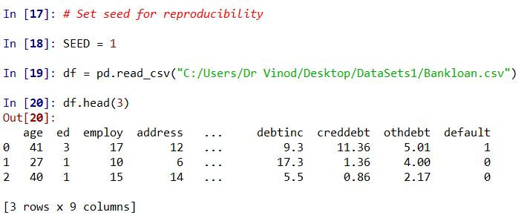
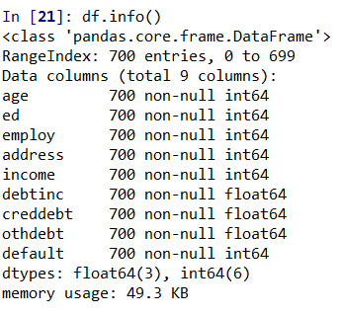
Import Data: bankloan.csv

Slide 4
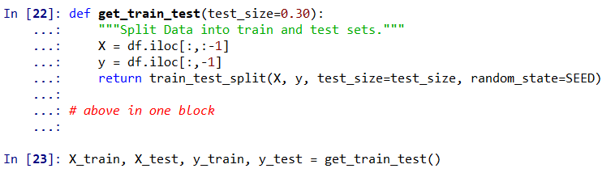
Create Train and Test data

Slide 5
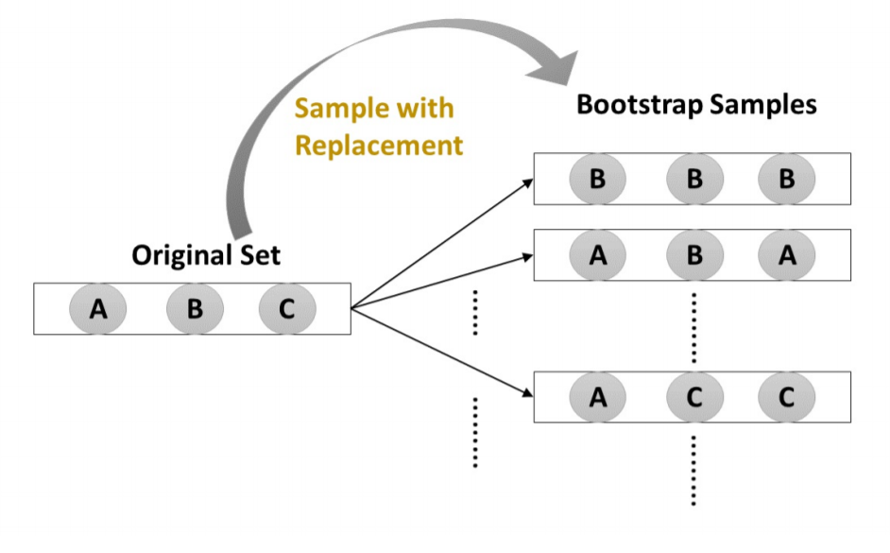
Bootstrapping

Slide 6
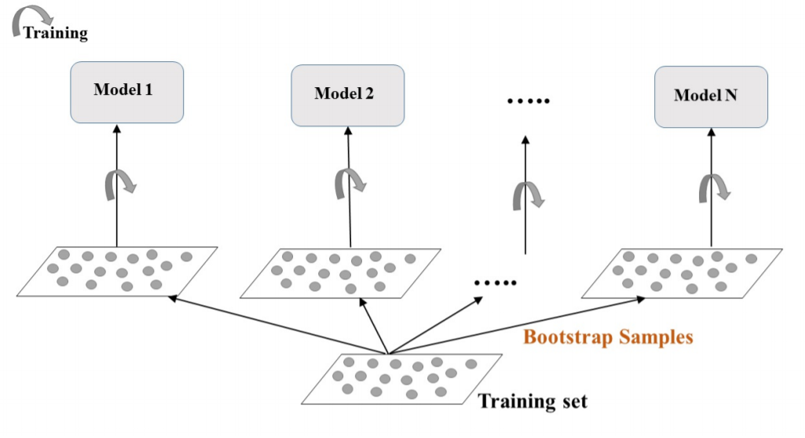
Bags of Samples

Slide 7
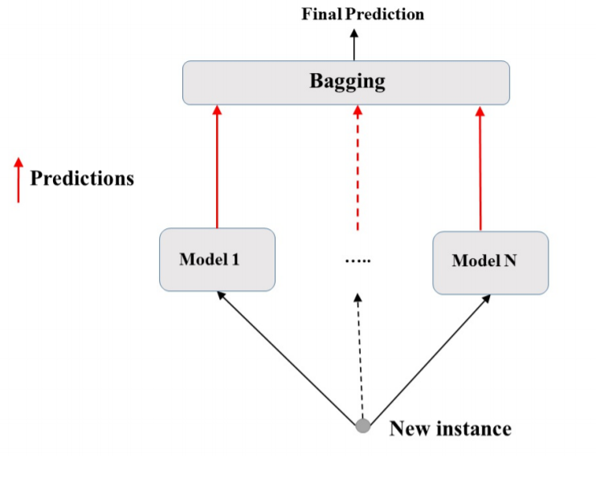
Final verdict by voting

Slide 8
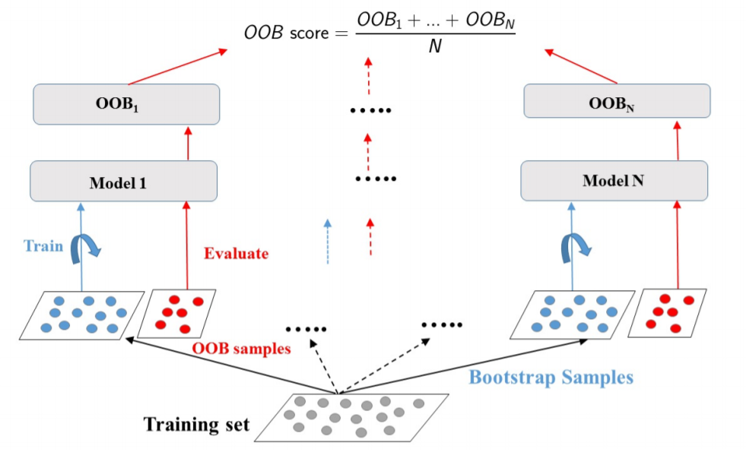
Final verdict by voting
Majority
Row 1 by LR = 0
by SVM = 0
by DT = 1

Slide 9
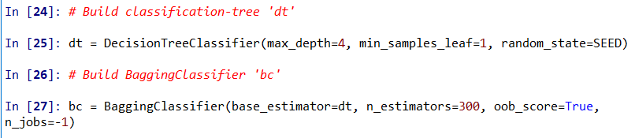
Base classifier and Bags

Slide 10
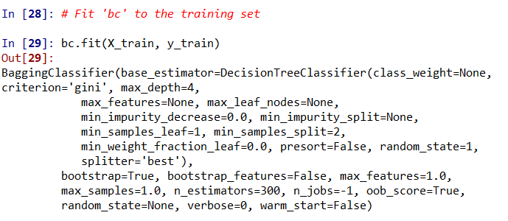
Build bagged model

Slide 11
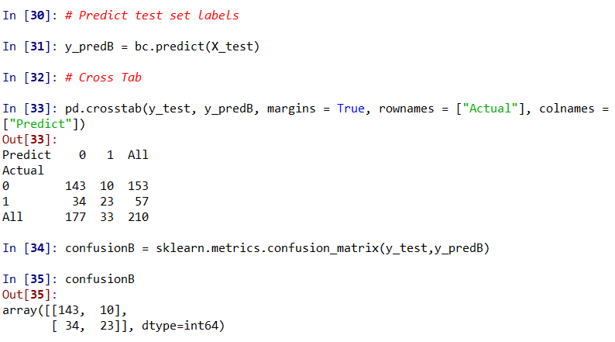
Predict on test data

Slide 12
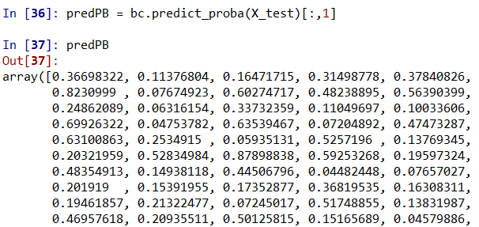
Find Probabilities of being 1

Slide 13
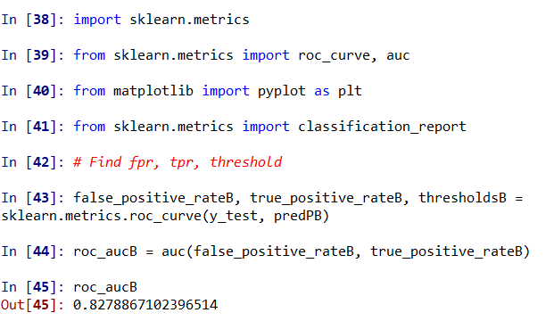
Preparation for ROC Curve and AUC

Slide 14
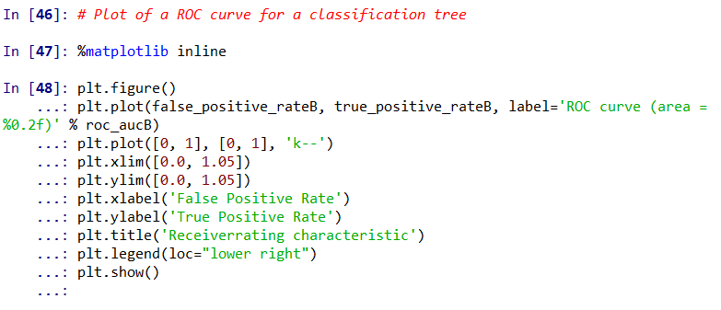
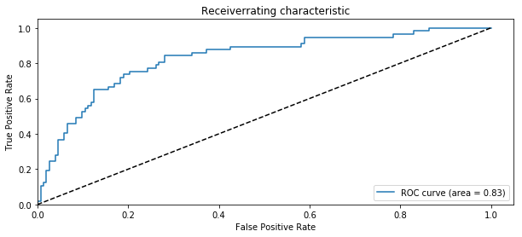
ROC Curve

Slide 15
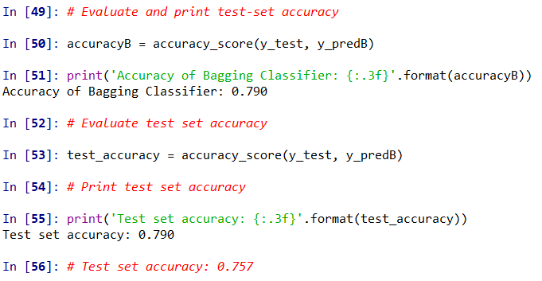
Test Accuracy
Ignore these, just a repetition!

Slide 16
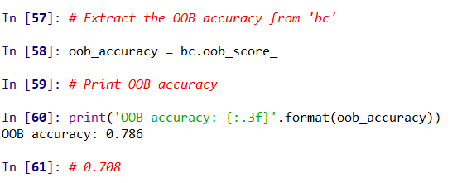
Out of Bag results/predictions

Slide 17
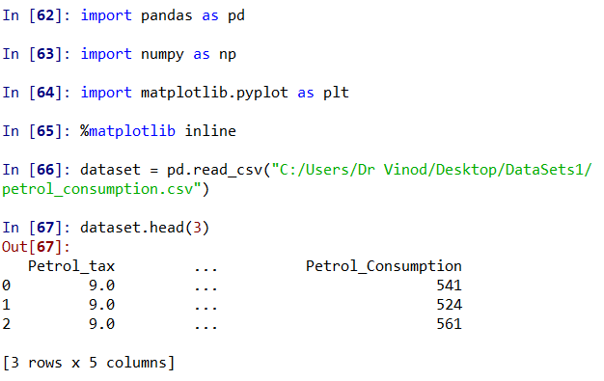
Bagging in Prediction/Regression

Slide 18
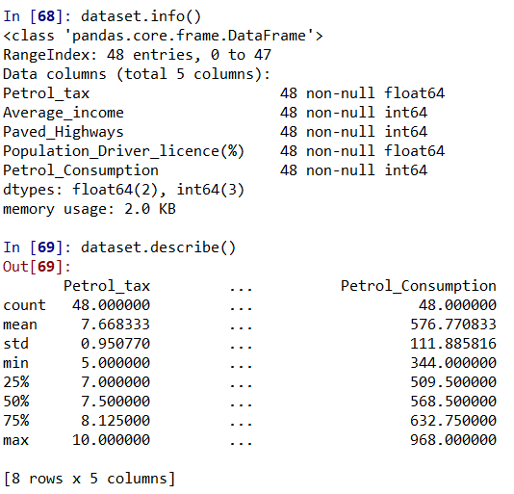
Know your Data

Slide 19
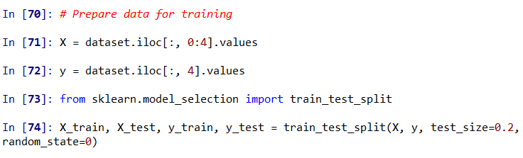
Train and Test data

Slide 20
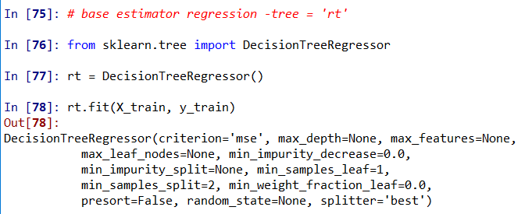
Base Regressor: A Tree

Slide 21
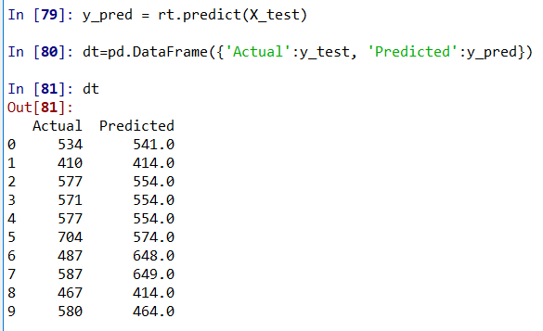
Predict

Slide 22
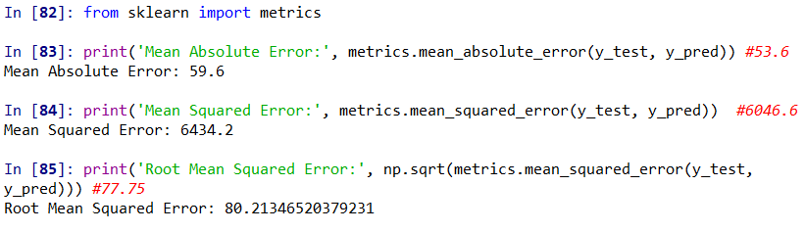
Predict

Slide 23
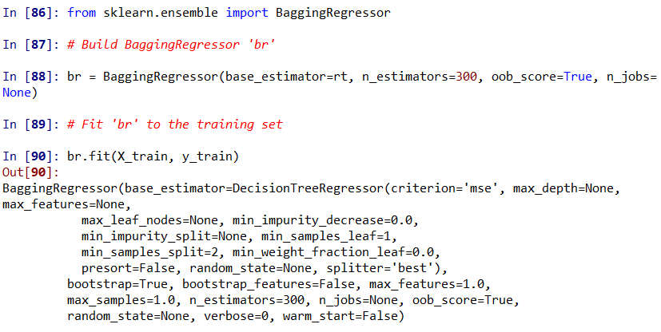
Bagging

Slide 24
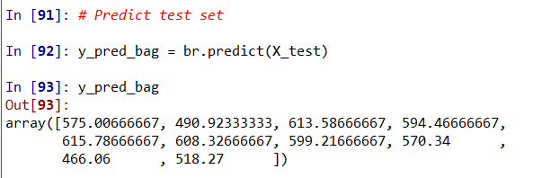
Predict Bagging

Slide 25
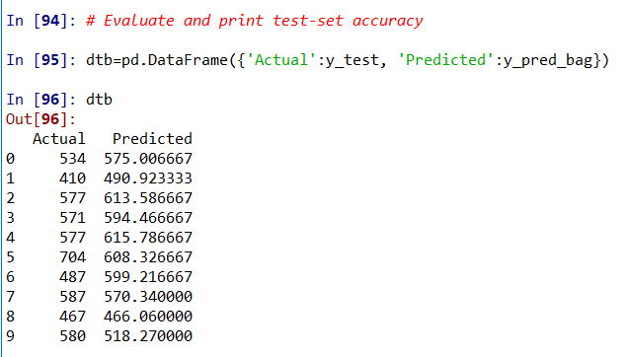
Predict and see in data frame

Slide 26
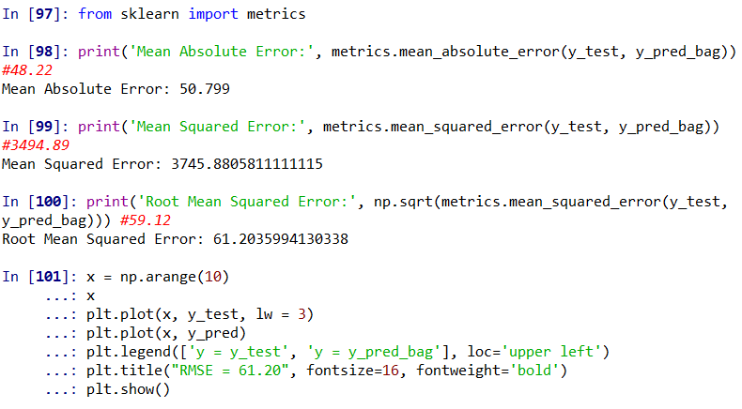
See metrics of prediction and plot

Slide 27
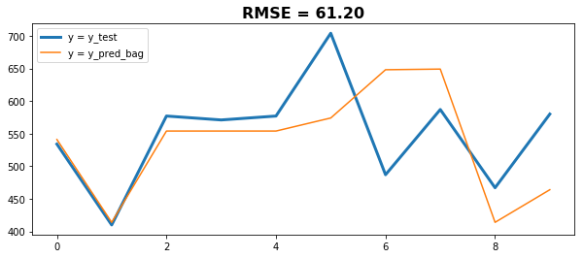
Line diagram: base versus Bag

Slide 28
Happy Learning!

